Slide 1
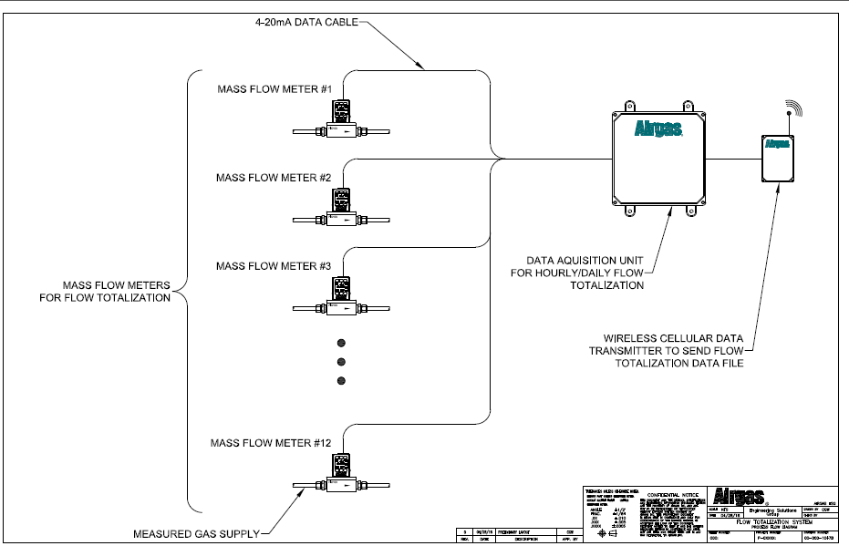
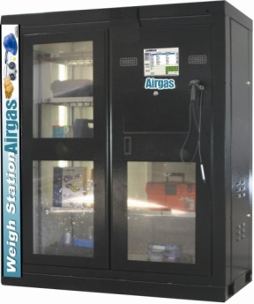
Benchmarking consumption using the WEA
Gas to Wire
• Wire to GMAW Gun Consumables
• Flux to Wire
• Wire to Grinding Discs
• Wire to Anti-Spatter
Wire Data Collection
Consumable Data Collection
Gas Data Collection

